Slide 1
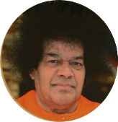
Ati Rudra Parayanam Feb 5 to Feb 15, 2015 Sunnyvale, California Miami, Florida
Om Sri Sairam! Om Namah Sivaya
All are invited to join prayers for world peace
Sri Rudram is a powerful hymn that imparts physical and mental healing. Ati Rudra Parayanam entails Rudram chanting by 121 devotees, 11x a day for 11 days. This offering is for the healing of those affected by the deadly Ebola epidemic and stop its global spreading.
For details of the event and sign up please visit: http://atirudram.us
SAMASTHA LOKAH SUKHINO BHAVANTHU

